Slide 1

Hospital Management System
230 Java SL AK - Java Microservices - RLL - Group 5

Slide 2

Group Members
Dachepally kiran
Dhaneshwaran C
Hariprakash G (Team Lead)
Karthik V
Boda keerthana
Chandan kumar
Deepika R
Ranganayaki palanisamy
Lakkasani ramesh reddy
Bharath reddy

Slide 3

CONTENTS
Abstract
Tools & Technologies
Project Architecture
Spring boot
Service explanation
Outputs
Advantages
Conclusion

Slide 4
ABSTRACT
The project Hospital Management system includes registration of patients, storing their details into the system, and also computerized invoice
The software has the facility to give a unique id for every patient and stores the details of every patient and the staff automatically.
Patients can search availability and details of a doctor and doctors can view the details of a patient using the id. The Hospital Management System can be entered using a username and password.

Slide 5




TOOLS & TECHNOLOGIES
Server-side: Spring Boot, Spring Cloud, Spring Data JPA
Database: MySQL
Server: Embedded Tomcat
DevOps: Docker, Git Hub
Spring Cloud: Spring Cloud Config, Spring Cloud Netflix Eureka, Feign, Resilience4j, Retry, Sleuth and Zipkin

Slide 6
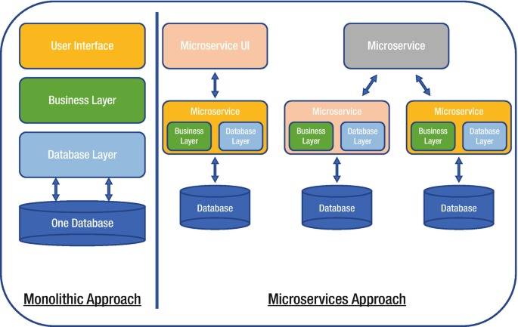
PROJECT ARCHITECTURE

Slide 7

SPRING CLOUD
Spring Boot
Spring Cloud Config
Spring Cloud Netflix Eureka
Feign
Resilience4j
retry
Sleuth and Zipkin.

Slide 8
Spring Boot
Spring Boot, an open-source Java framework, empowers the creation of autonomous and production-ready microservices, providing robust infrastructure support and streamlining the development of enterprise-level applications.

Slide 9
Spring Cloud Config Server
Spring Cloud Config Server to centralize configuration in a Git repository, then configure microservices to fetch their properties from this server, enabling dynamic configuration management for a hospital management system.

Slide 10
Spring Cloud Netflix Eureka
Spring Cloud Netflix Eureka for service discovery and registration in a hospital management system, allowing microservices to easily locate and communicate with each other within the architecture.

Slide 11
Feign
Feign to simplify RESTful service communication within a hospital management system, allowing microservices to declare their interactions as simple Java interfaces and enabling seamless integration and data retrieval between components.

Slide 12
Resilience4j
Resilience4j in a hospital management system is used to enhance its fault tolerance and resilience. This includes features like circuit breakers, retries, and fallback mechanisms to ensure the system can gracefully handle failures and recover from errors.

Slide 13
Retry
retry mechanisms in hospital management system is used to automatically retry failed operations, enhancing its robustness and reliability, especially in scenarios involving external services or network issues.

Slide 14
Sleuth and Zipkin
Sleuth and Zipkin in hospital management system to enable distributed tracing and monitoring of requests across microservices. This facilitates detailed insights into request flows, performance tracking, and issue debugging within the system.

Slide 15

Admin Login
Admin login module : Managing administrative operations related to an entity called "Admin." It handles creating,
retrieving, and checking admin entities .
Save Admin: This operation is handled by the saveAdmin method It is used to save admin details with admin_id , username,
Email-id and Password .
Get All Admins: This operation is handled by the getAdmin method and It retrieves a list of all admin.
Check Admin Login: This operation is handled by the checkAdmin method and It takes an Admin object in the request body, checks if
the provided admin credentials are valid or not.
Get Admin by ID: This operation is handled by the getAdminById method and It takes an admin ID , fetches the corresponding admin.

Slide 16

Doctor Signup
Doctor module: Managing administrative operations related to an entity called “Doctor“. It handles creating, retrieving, updating, deleting, and checking valid Doctor login details by using appropriate HTTP endpoints.
Get All Doctors: This operation is handled by the getAllDoctors method and it retrieves a list of all doctors.
Get Doctor by ID: This operation is handled by the getDoctorById/{d_id} method and it takes a doctor’s ID and fetches the corresponding doctor.

Slide 17

Add Doctor: This operation is handled by the addDoctor method. It is used to save doctor details with the doctor’s name, gender, password, contact no, specialization, experience, salary, and acceptance status details.
Update Doctor: This operation is handled by the updateDoctor method. It is used to update details of the doctor’s name, gender, password, contact no, specialization, experience, salary, and acceptance status details by providing the doctor’s unique ID.
Delete Doctor: This operation is handled by the deleteDoctor method. It is used to delete the doctor from the list.

Slide 18

Doctor login
Doctor-Login requires doctor's username and password.
When doctor logins with username and password it checks for it in the database.
Receives an AuthenticationStatus object as the result.

Slide 19

Discharged Patients
Storing and retrieving information about discharged patients, including their medical history, and discharge details.
Save Discharged Patient: This operation is used to save details of a discharged patient in the system
Get All Discharged Patients: This operation retrieves a list of all discharged patients in the system.
POST Method: Add Discharged Patient. This operation is used to add a discharged patient to the system.

Slide 20
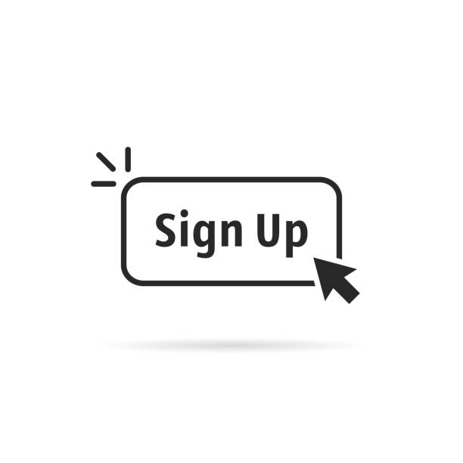
Patient Sign-Up
This module is responsible for patient sign-up operations, allowing users to register as patients.
Key functionalities include creating, retrieving, and validating patient entities.
Save Patient Sign-Up
Purpose: Saves patient registration details, including patient ID, name, username, password, gender, and contact number.
Get All Patients
Purpose: Retrieves a comprehensive list of all registered patients.
Update Patient Sign-Up
Purpose: Permits updates to patient registration information, such as name, username, password, gender, and contact number.

Slide 21
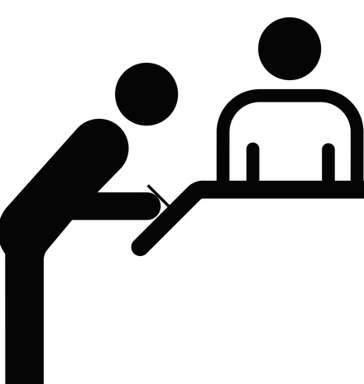
Delete Patient Sign-Up
Purpose: Removes a patient's registration record based on the provided patient ID.
Check Patient Login
Purpose: Verifies the authenticity of patient login credentials by comparing provided username and password against the stored records.
Get Patient by ID
Purpose: Retrieves specific patient registration details based on the patient's unique ID.

Slide 22

Patient Login
Patient-Login requires patient's username and password.
When patient logins with username and password it checks for it in the database.
Receives an AuthenticationStatus object as the result.

Slide 23

Appointment
Get all appointments
It is used to retrieve list of all appointments from the database.
Get appointments by id:
It is used to find an appointment by its ID.
Update appointments by id:
It is used to update an appointment by its ID.

Slide 24

Contd..
Post appointments :
It is used to post a new appointment .
Delete appointments by id :
It is used to delete appointments by id .

Slide 25
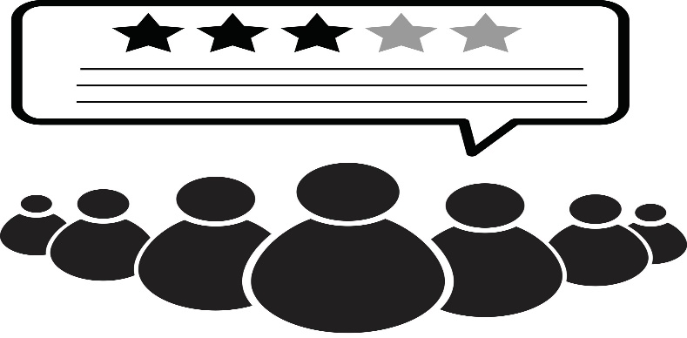
Feedback
Get All Feedbacks:
It is used to retrieve all the feedbacks provided by the patients about the doctor
Post Feedback:
It is used to post feedbacks by the patients about the doctor

Slide 26
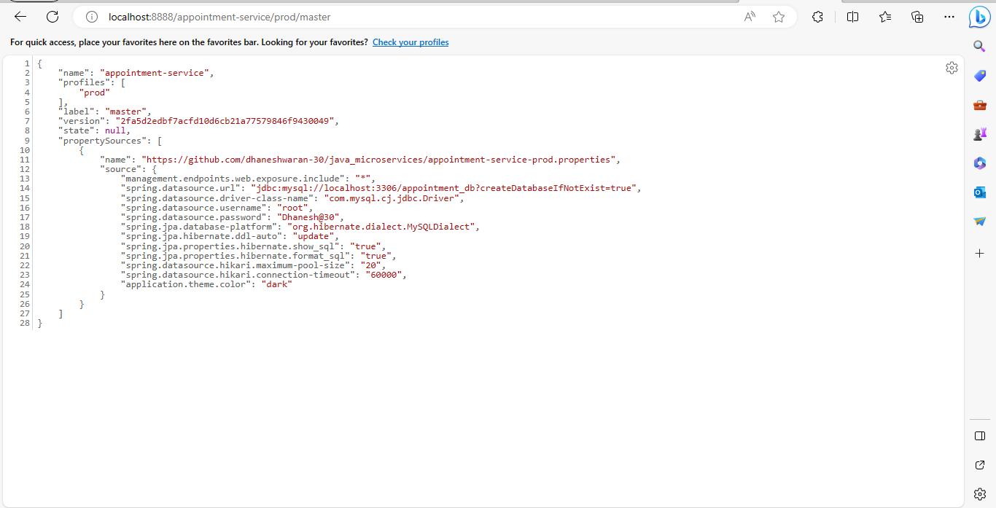
Prod properties using config server

Slide 27
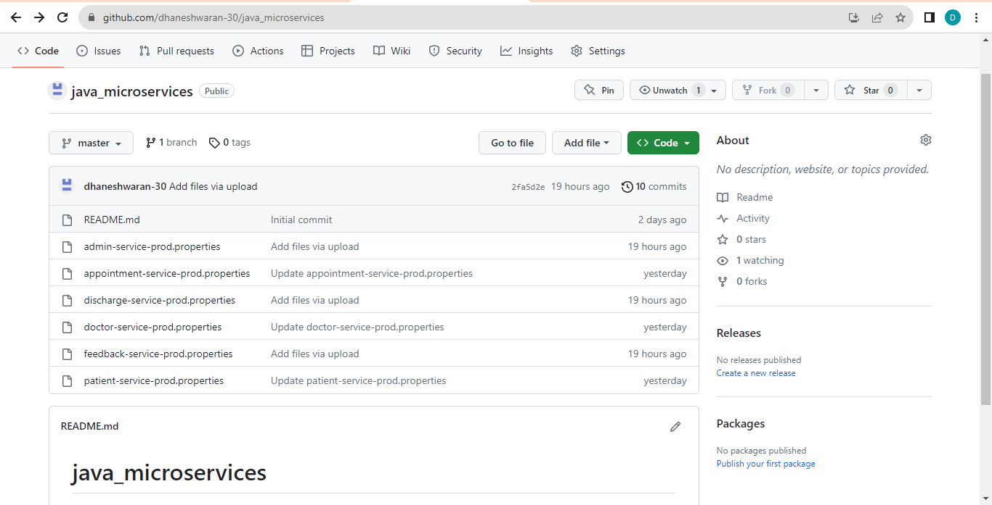
Prod properties file in github

Slide 28
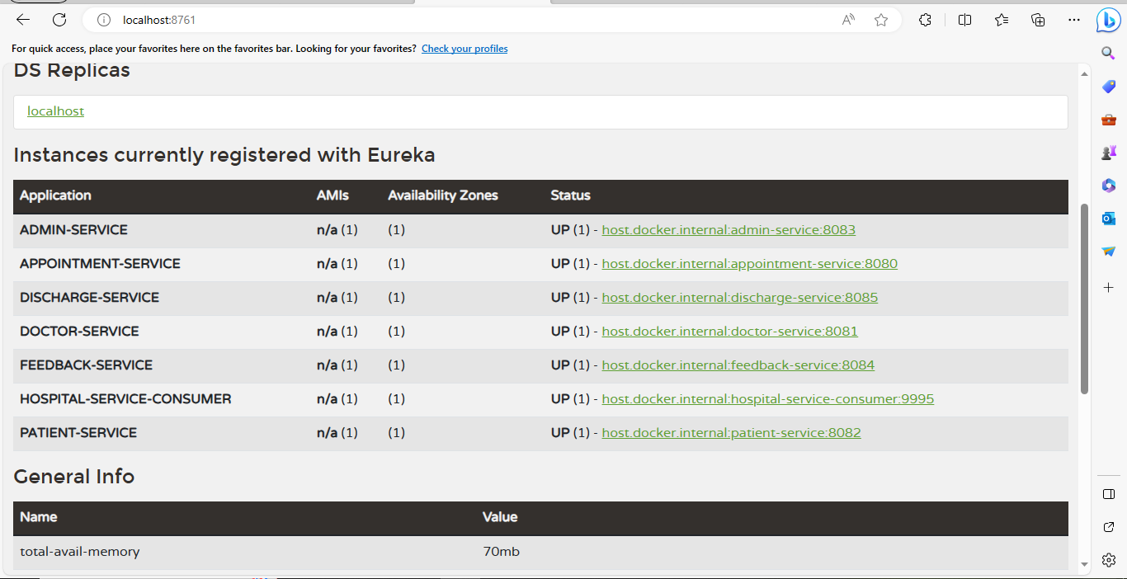
Registered services in Eureka

Slide 29
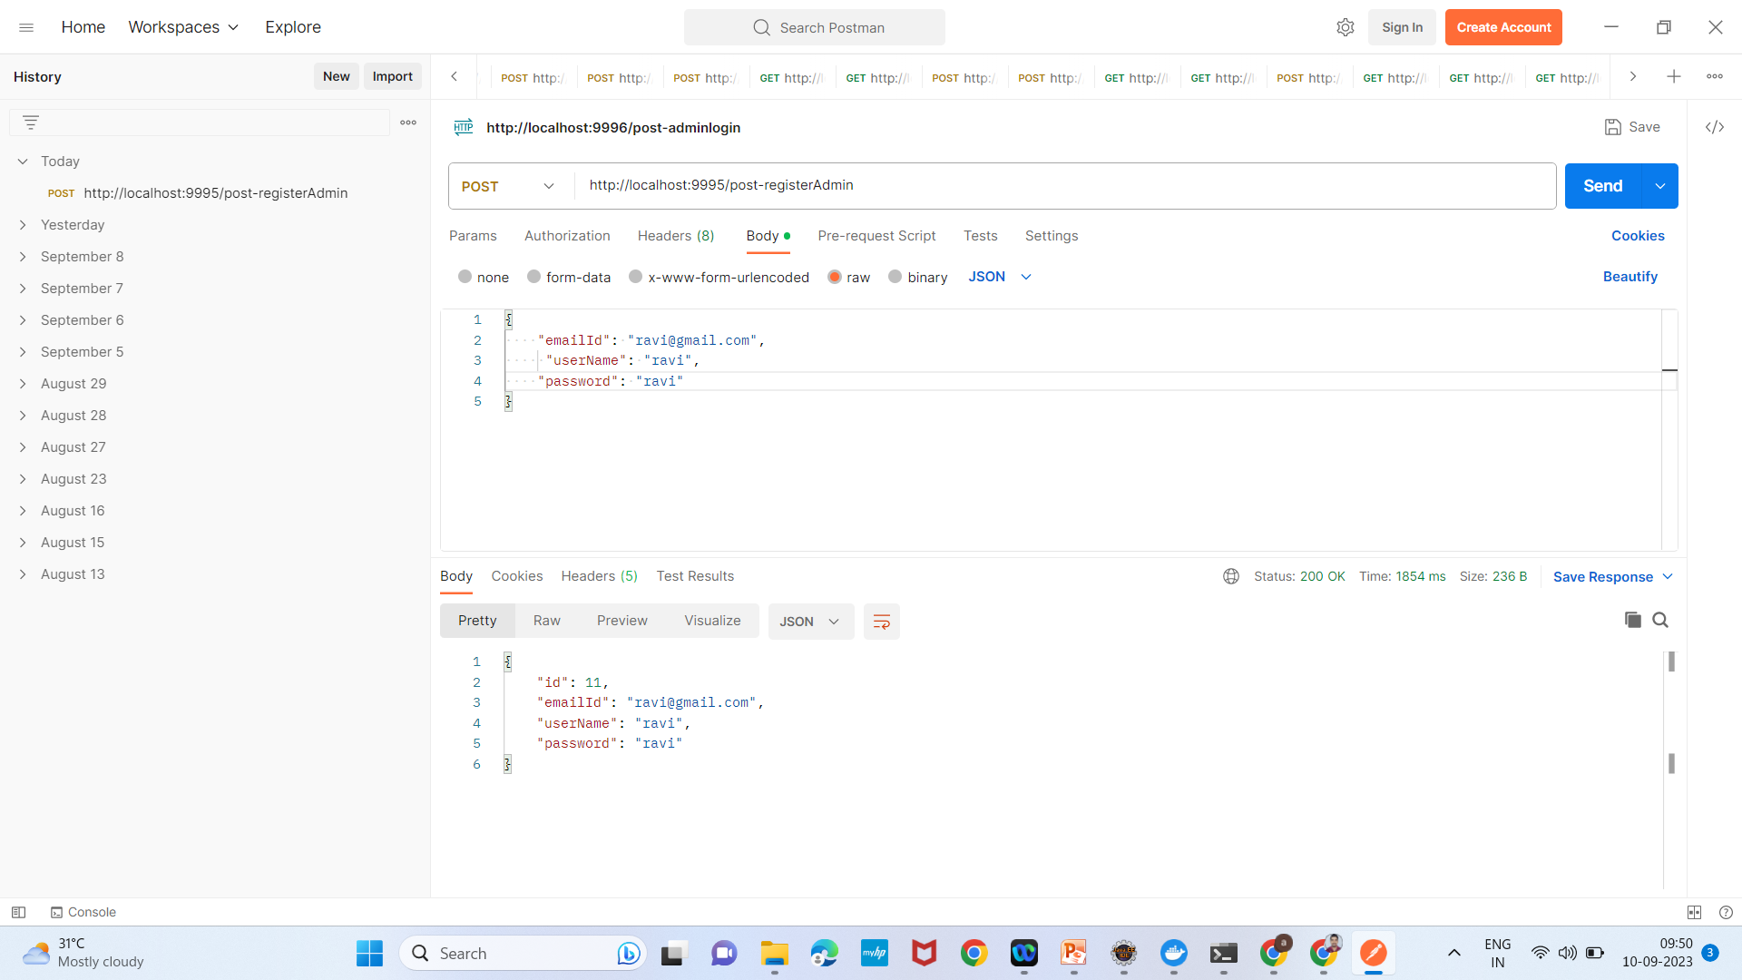
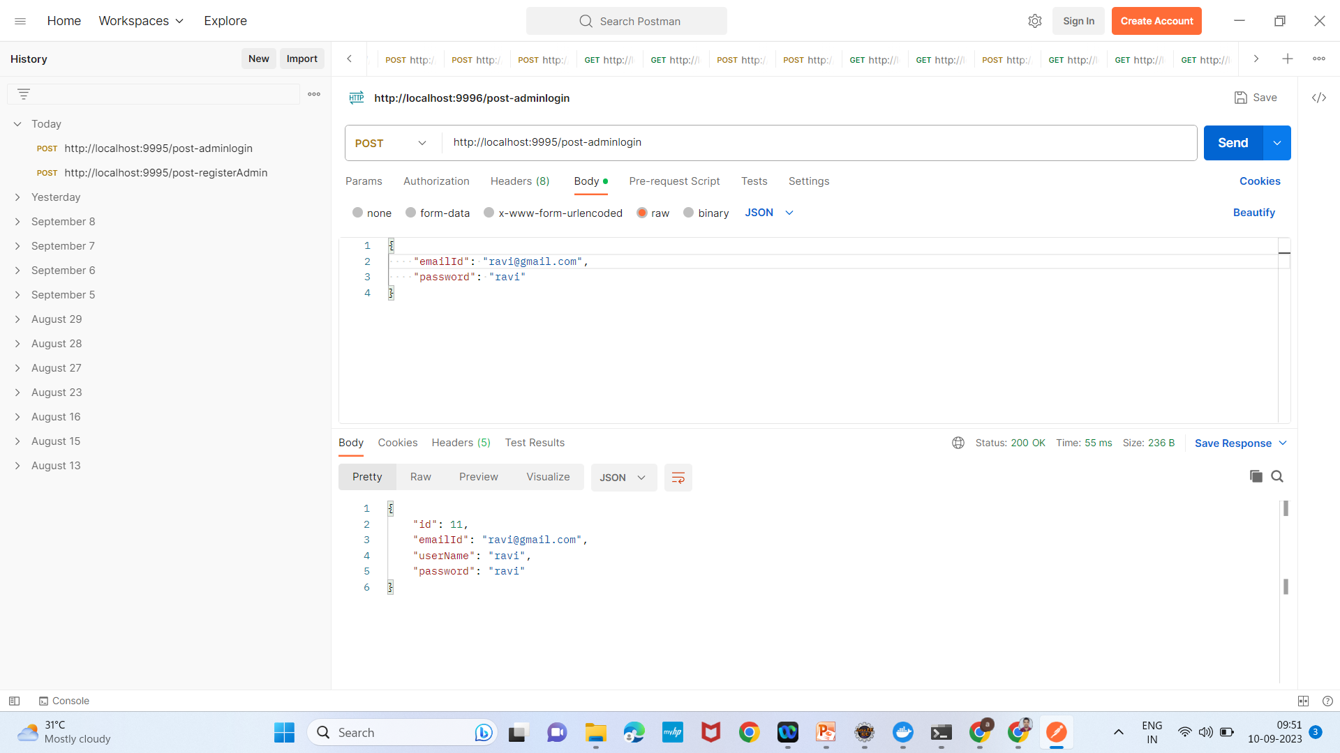
Admin Added Screenshots:

Slide 30
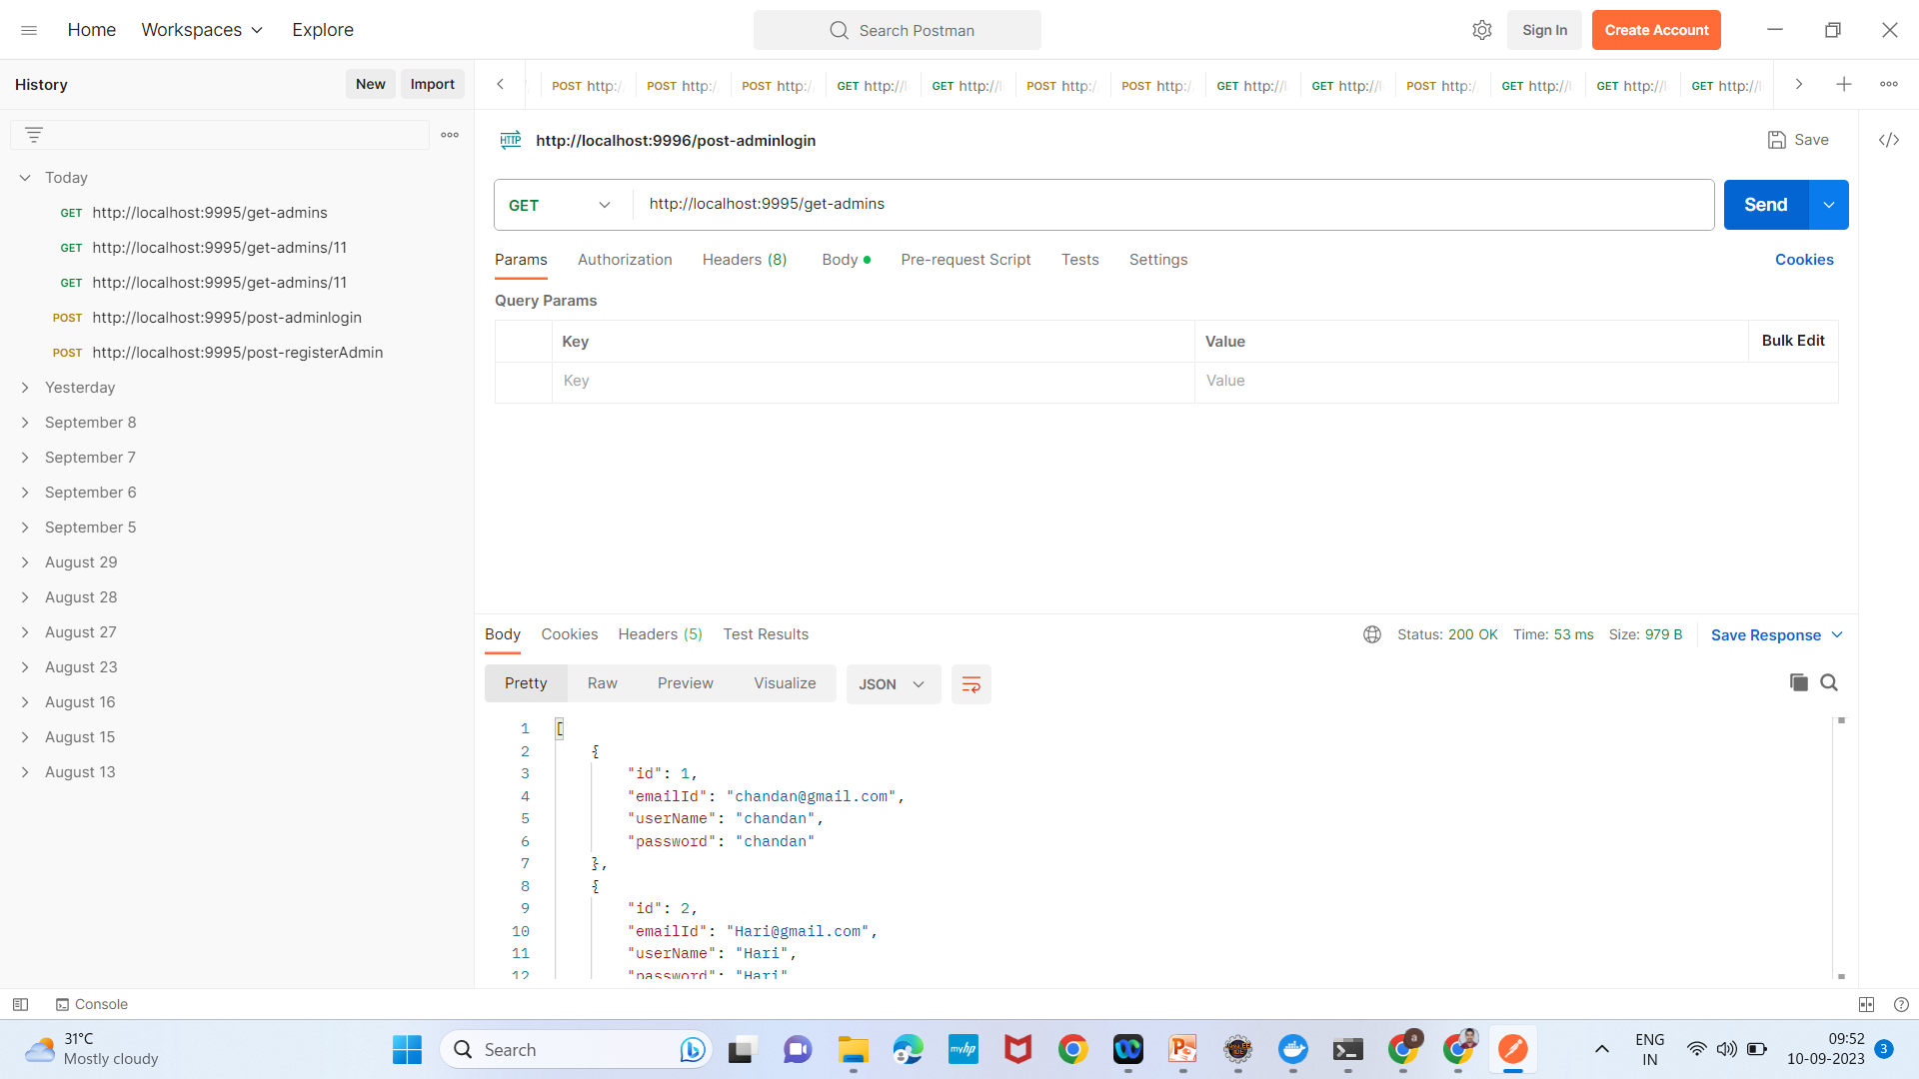
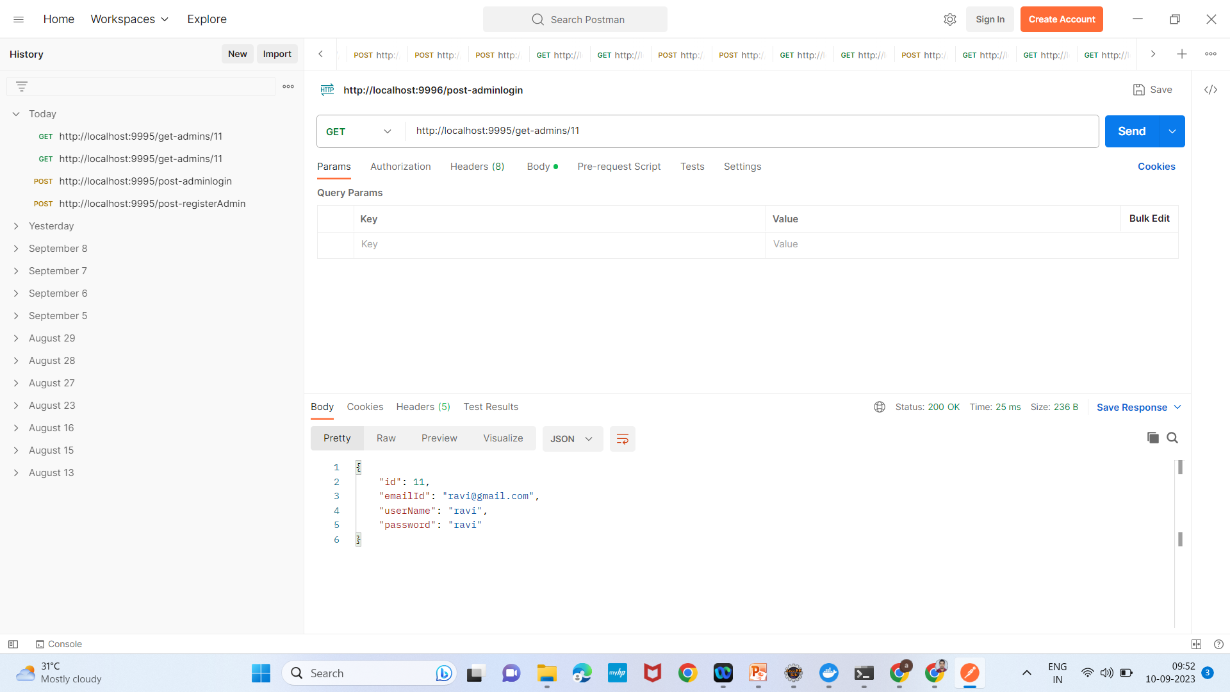
Admin

Slide 31
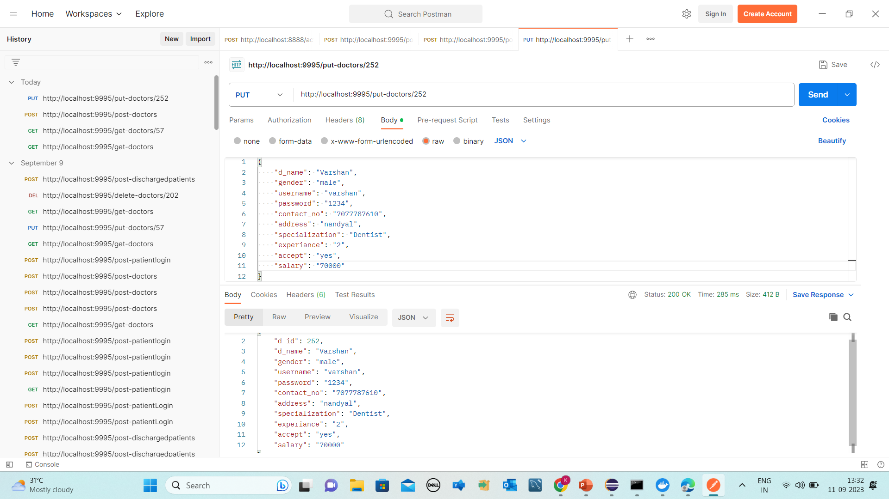

Doctor sign-up Screenshots

Slide 32
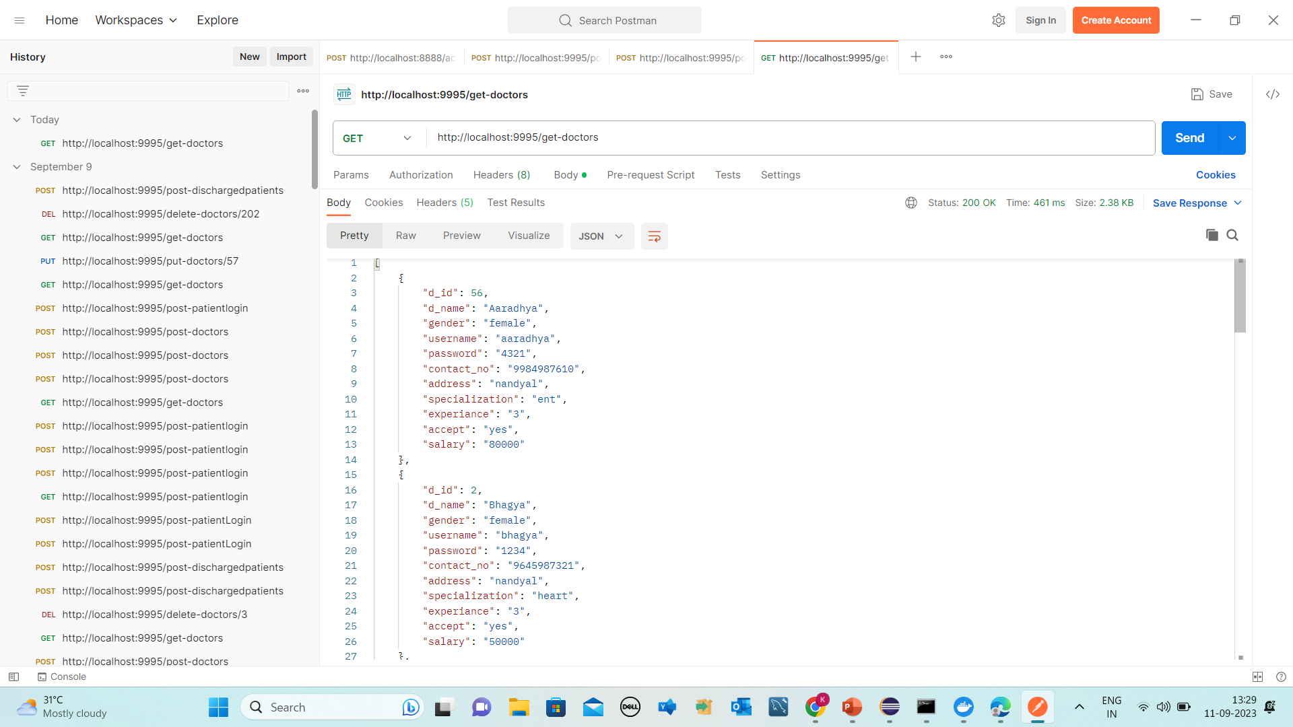
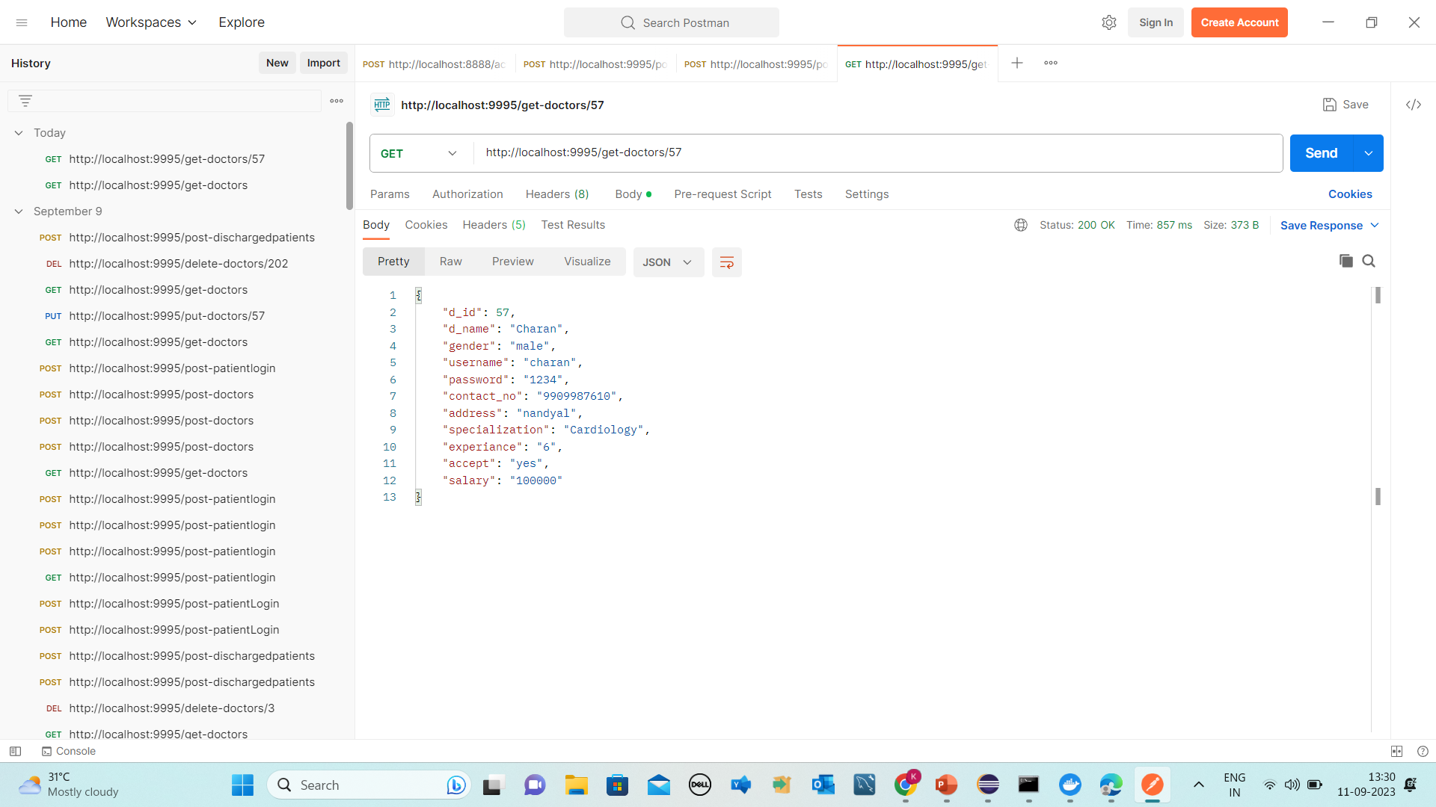
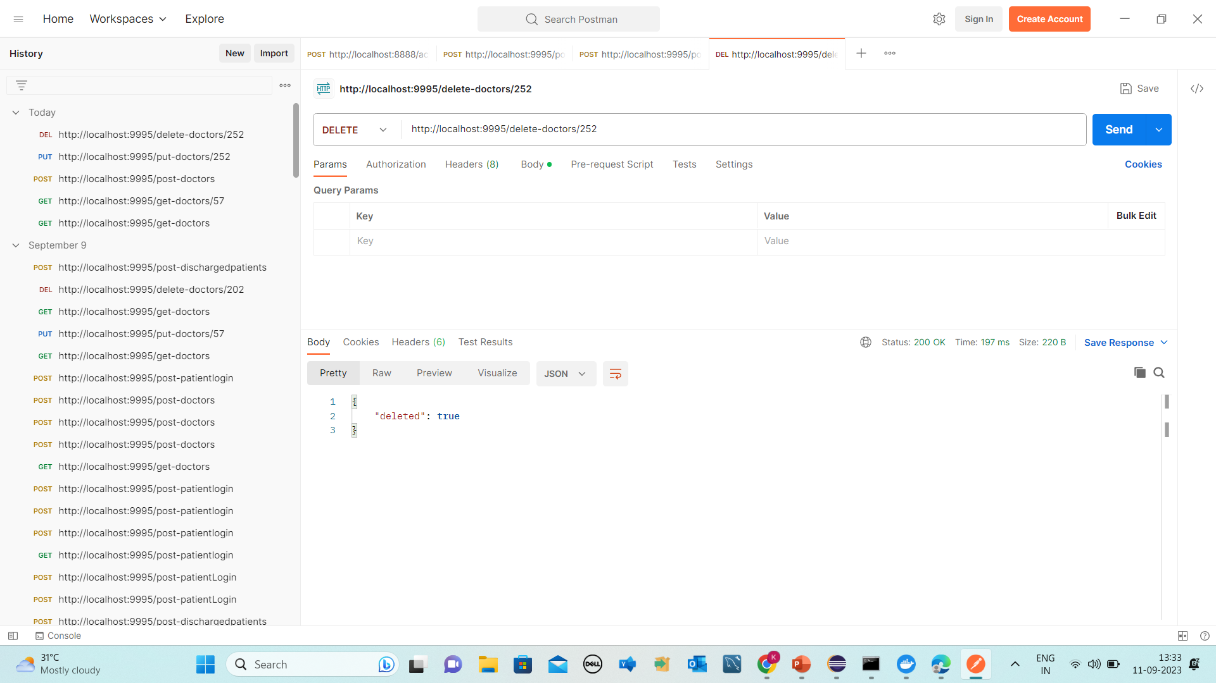
Doctor signup

Slide 33
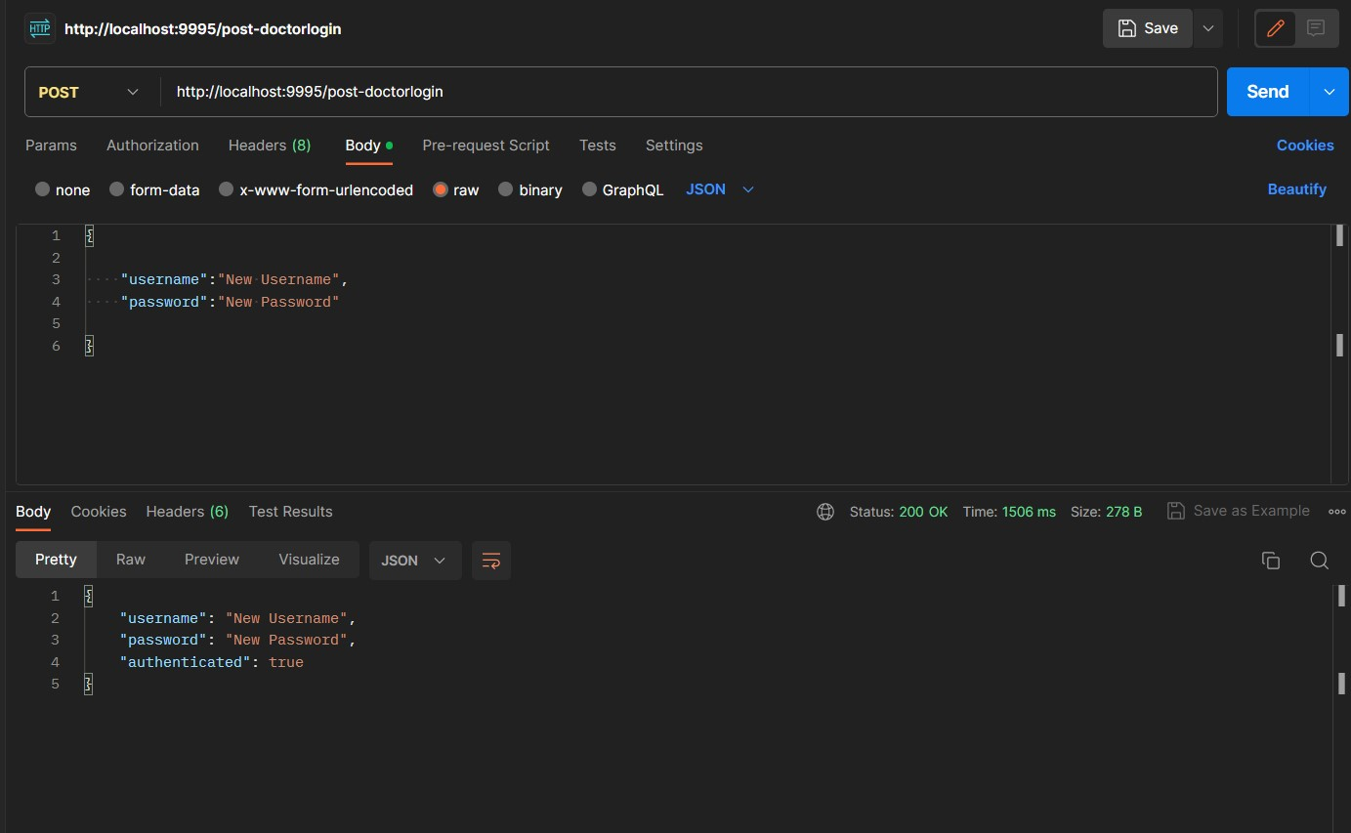
Doctor Login Screenshot

Slide 34
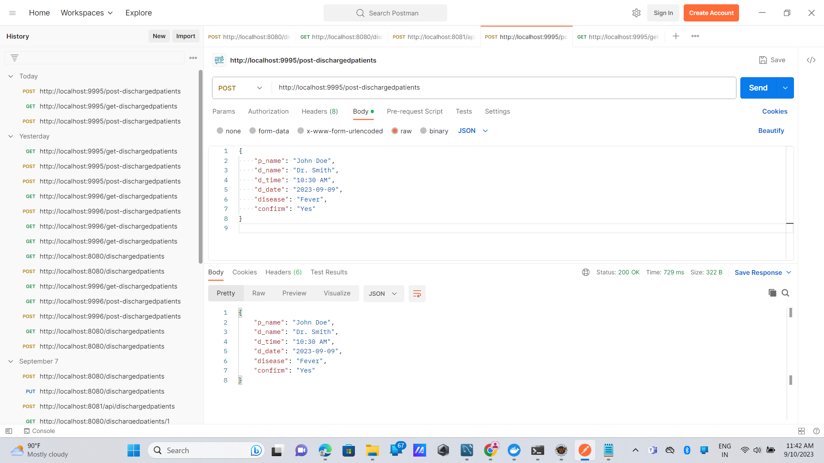
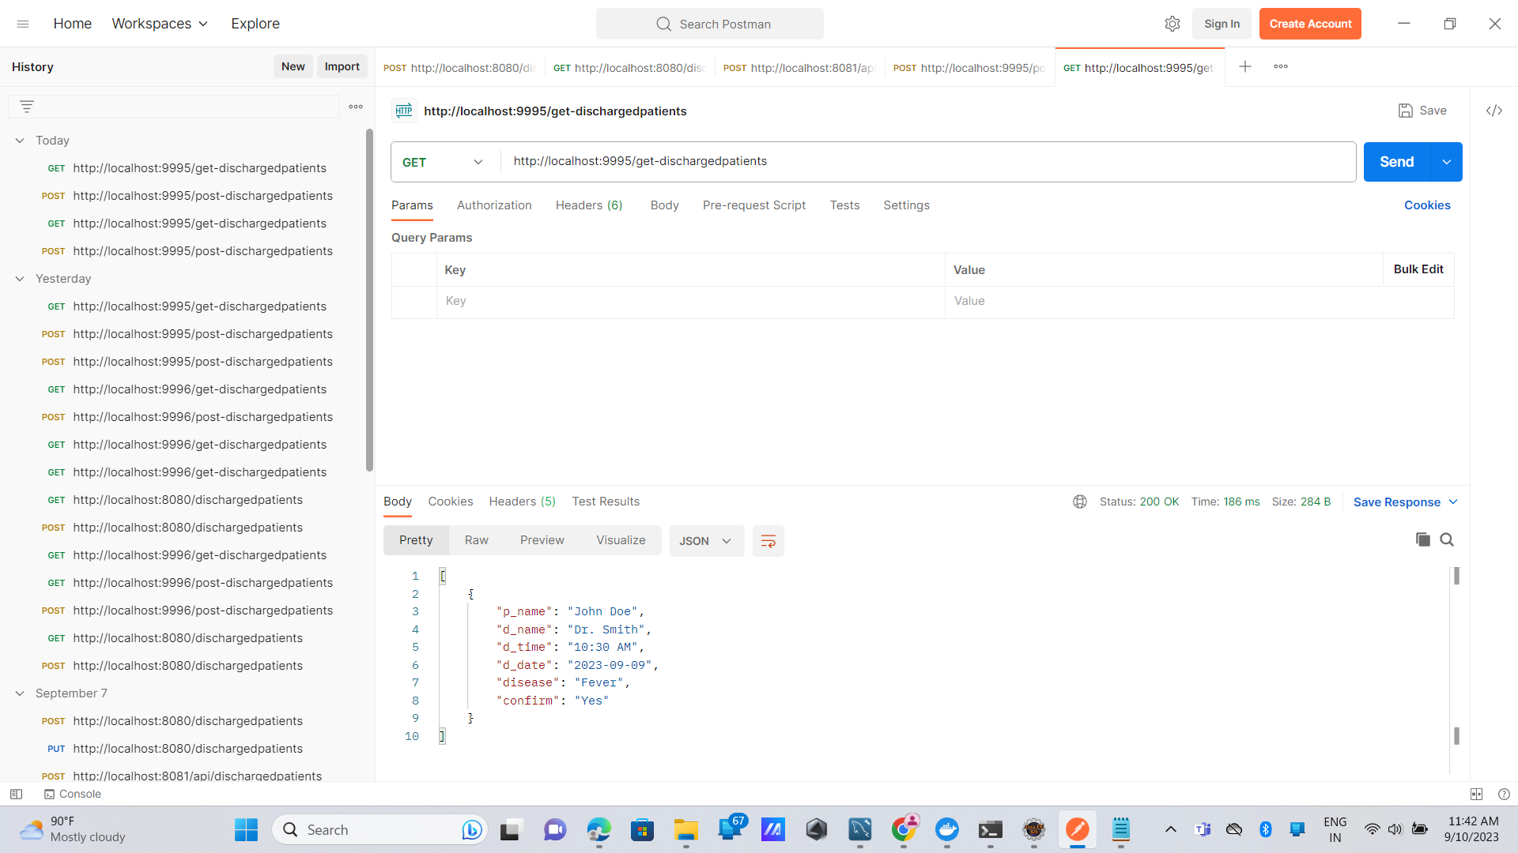
Discharge Patients Screenshots

Slide 35
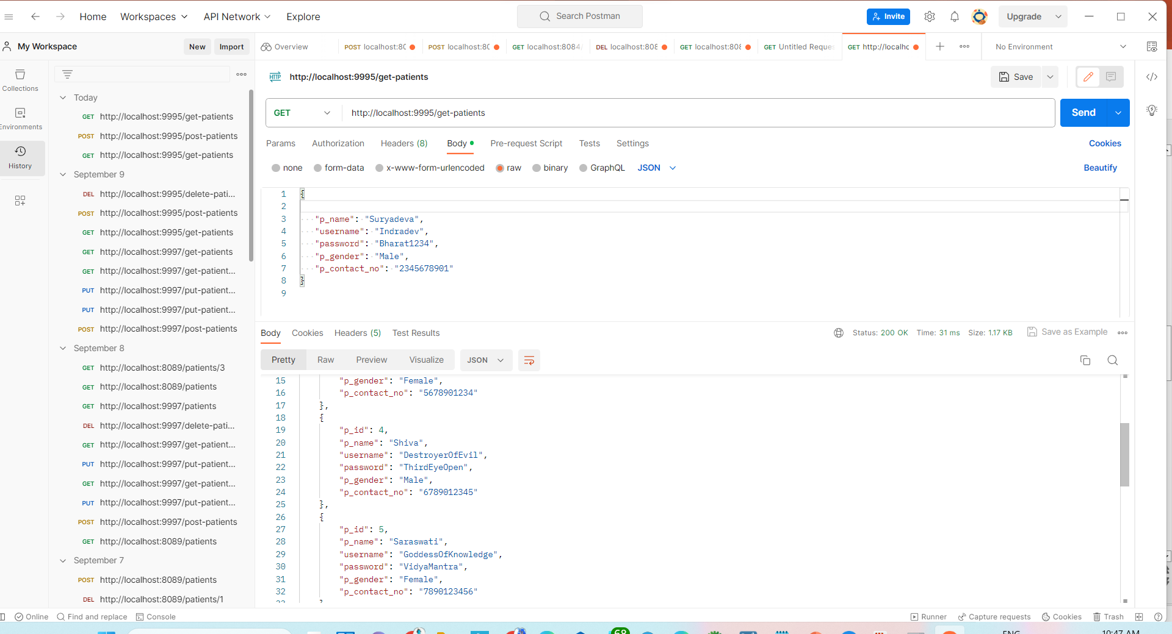
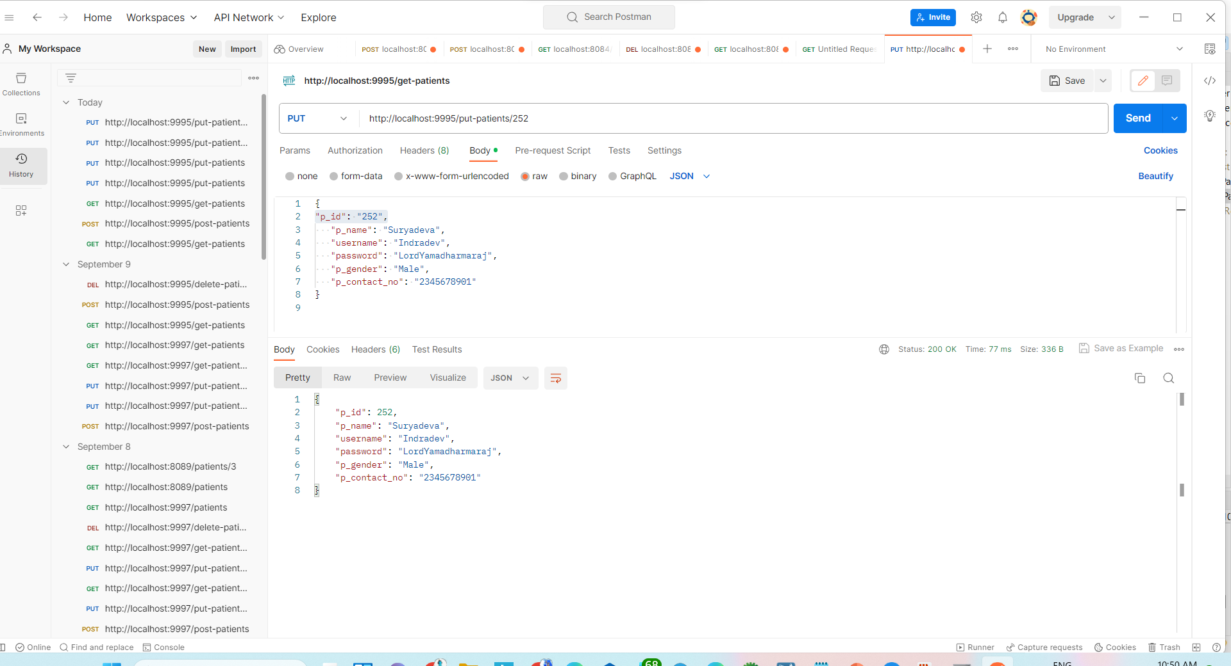
Patient Sign Up Screenshots:

Slide 36
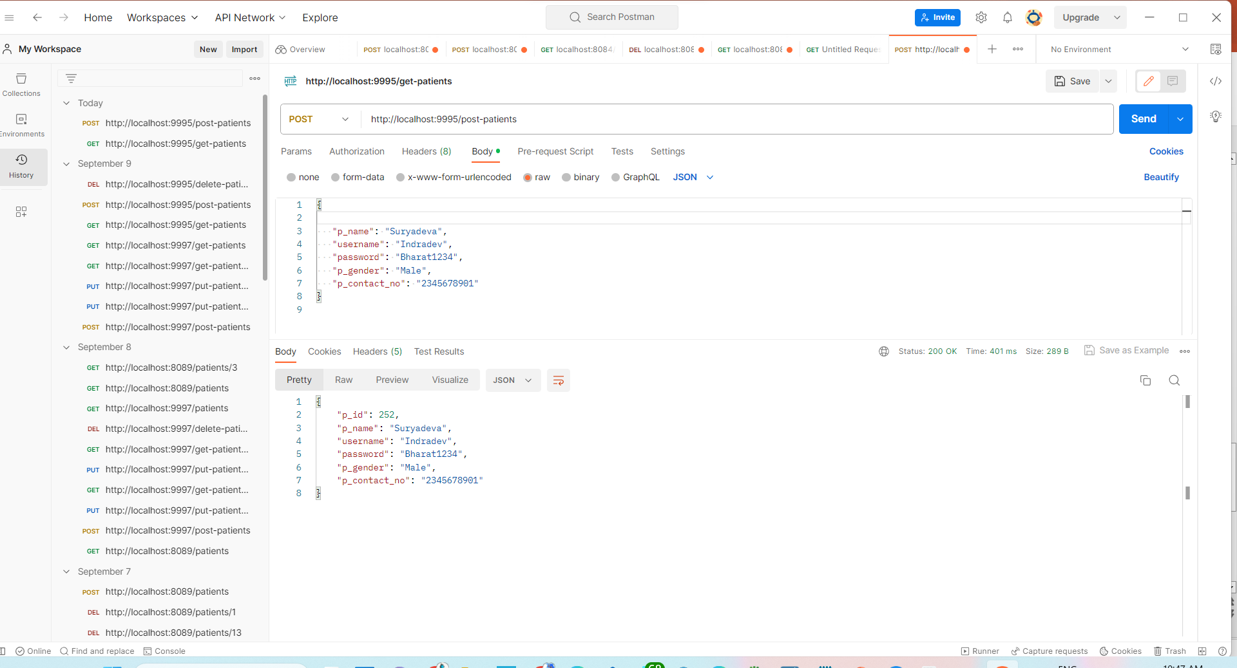
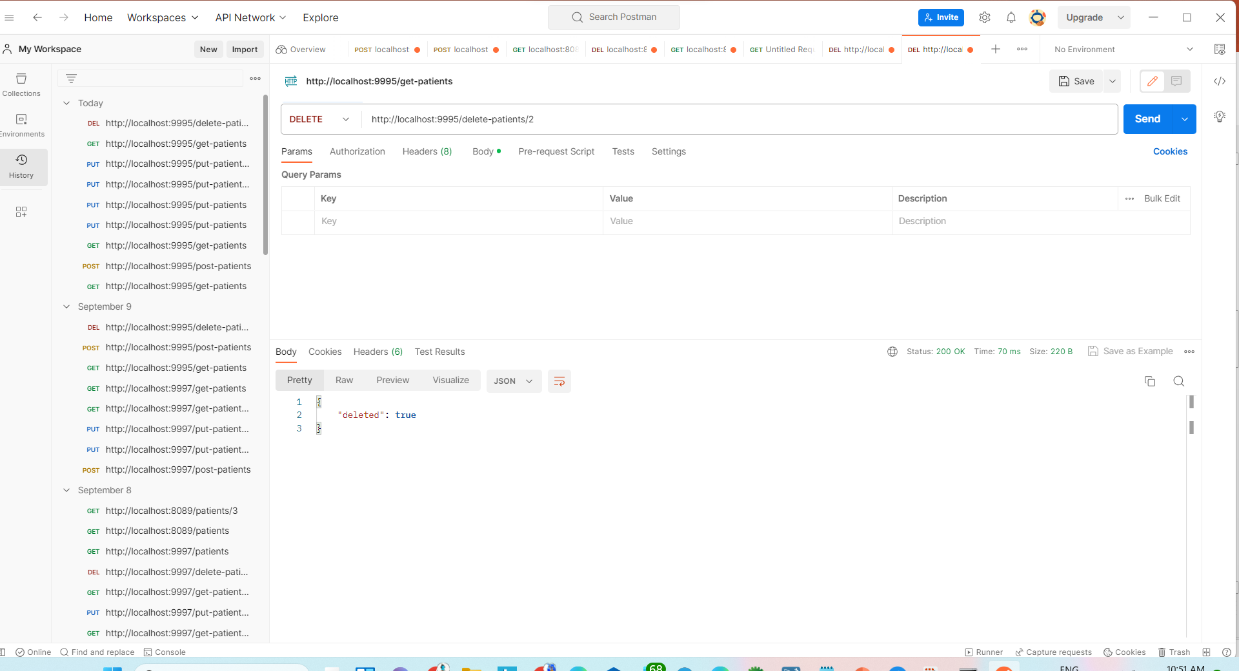
Patient Signup

Slide 37
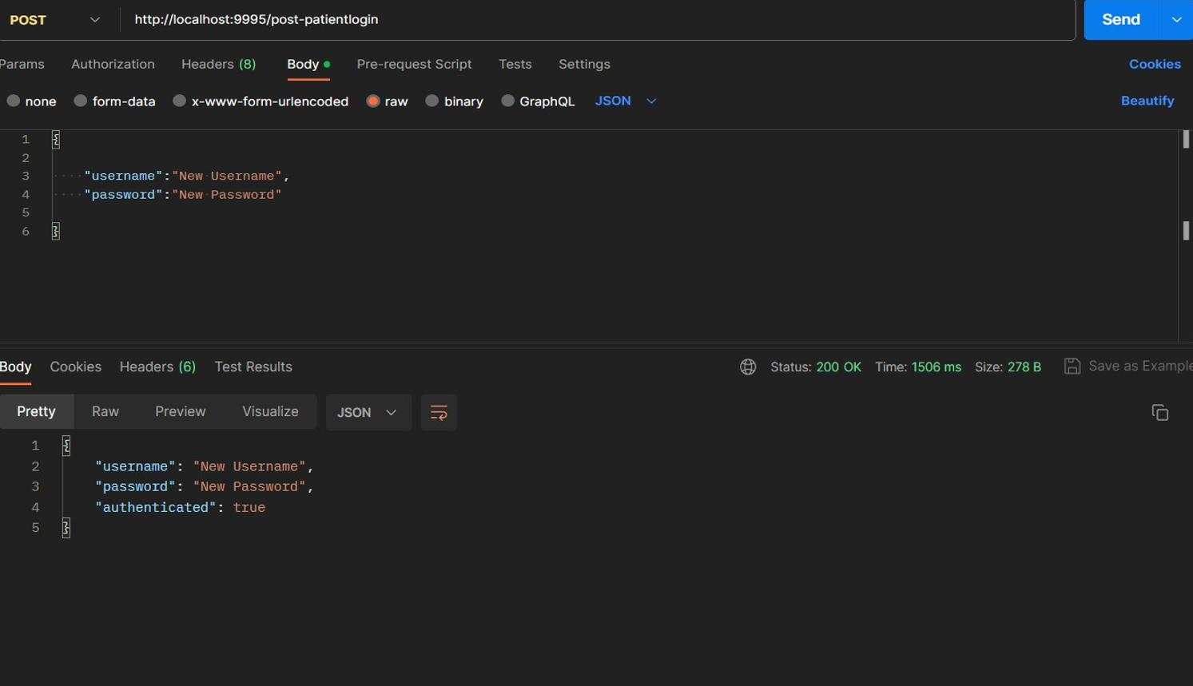
Patient Login Screenshot

Slide 38
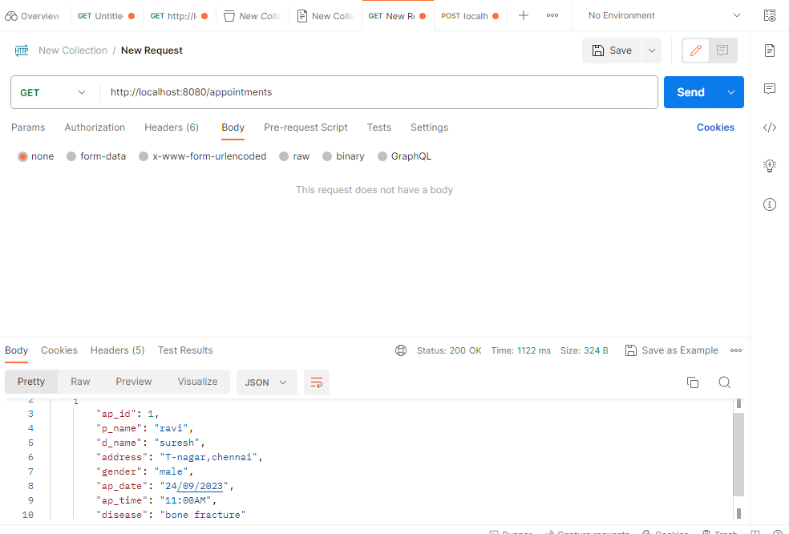
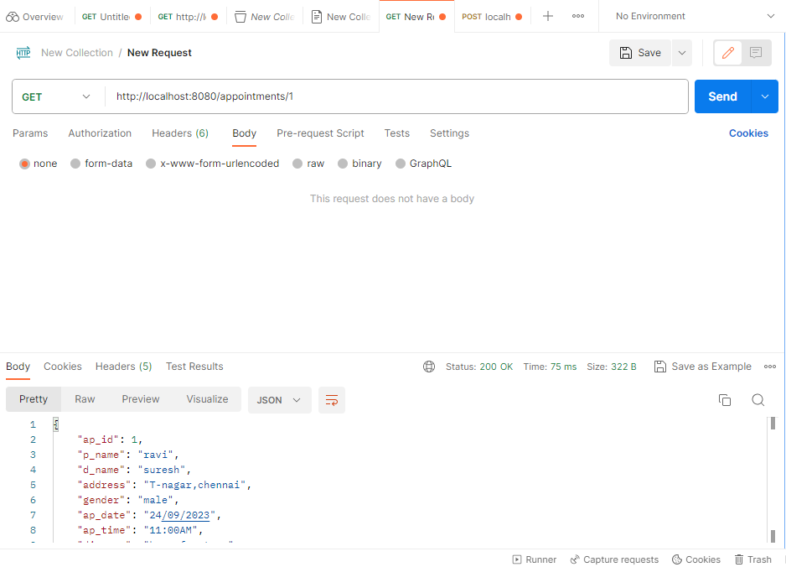
Appointment screenshots
1. Get all appointments 2. get appointments by id

Slide 39
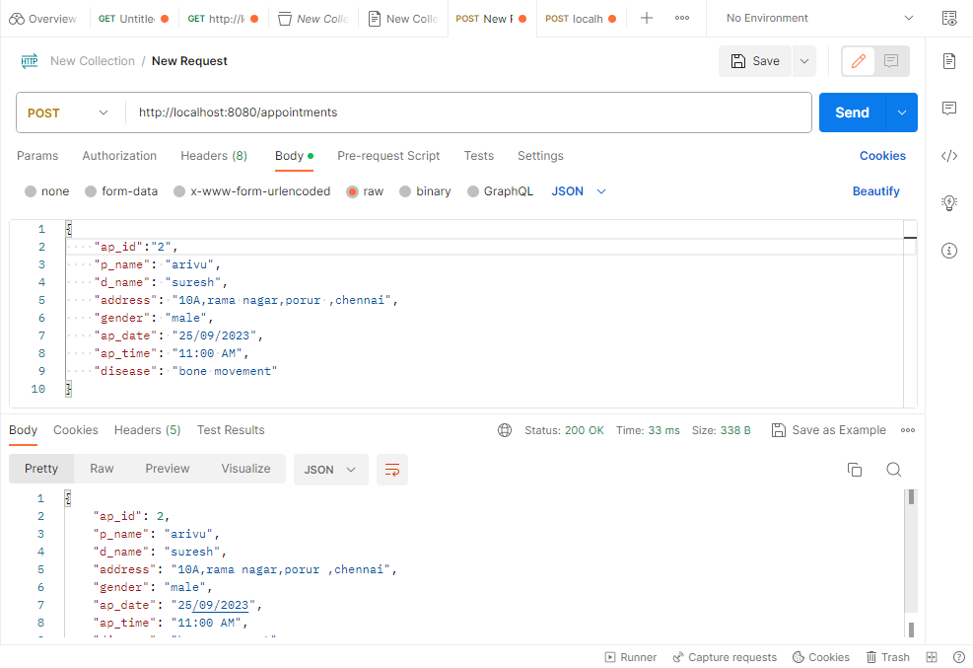

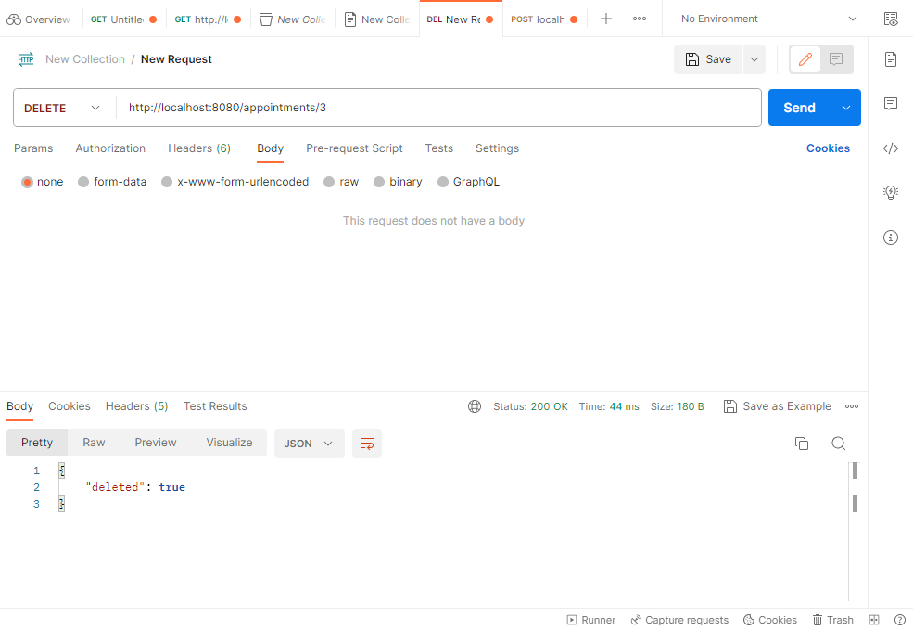
Appointment
3.post appointments 4.update appointments 5.Delete appointments by id

Slide 40
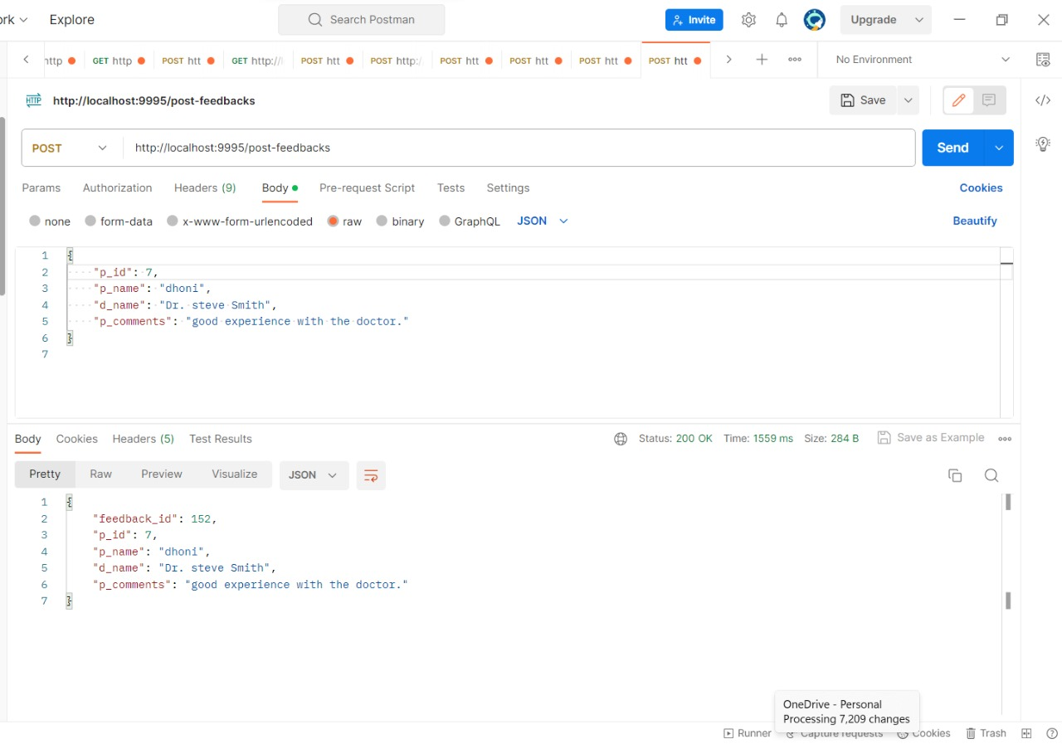
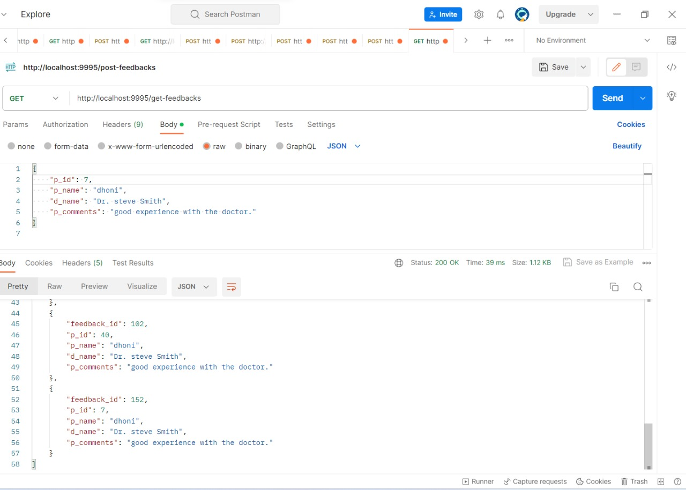
Feedback Screenshots

Slide 41
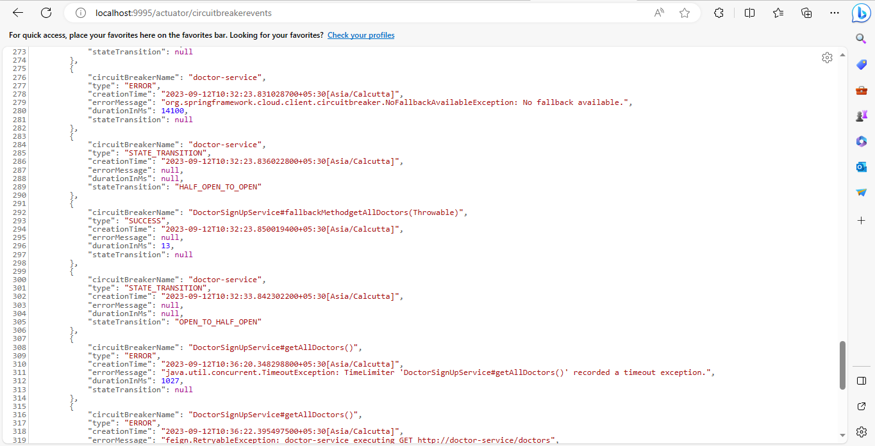
Circuit Breaker Events

Slide 42
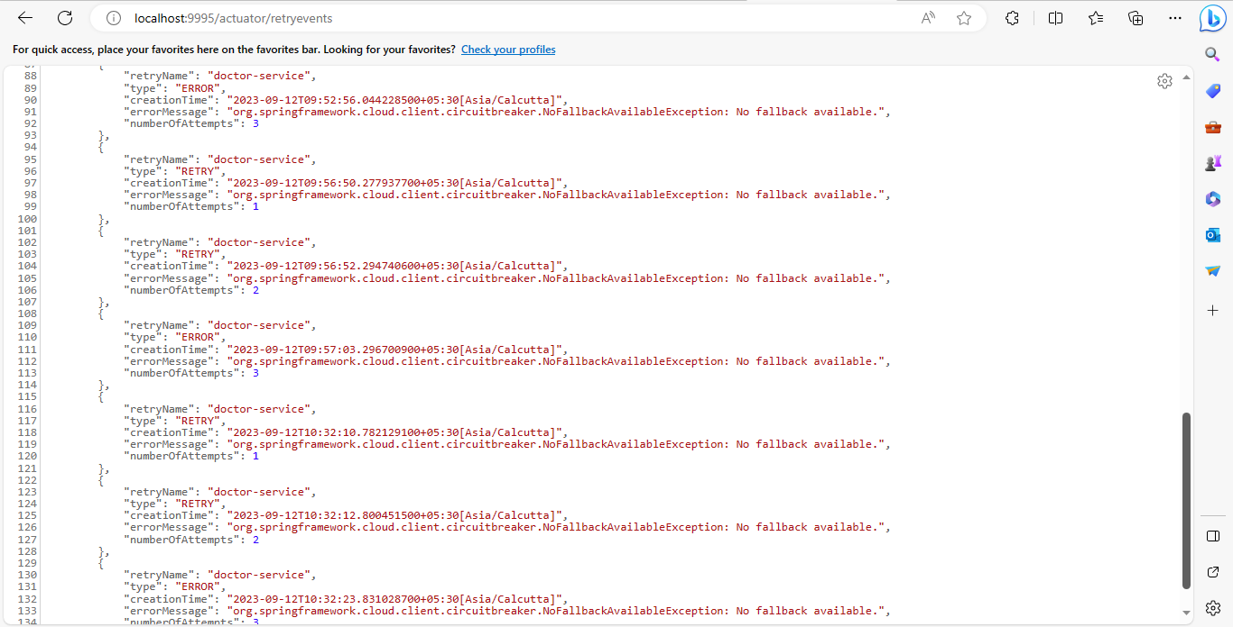
Retry Events

Slide 43
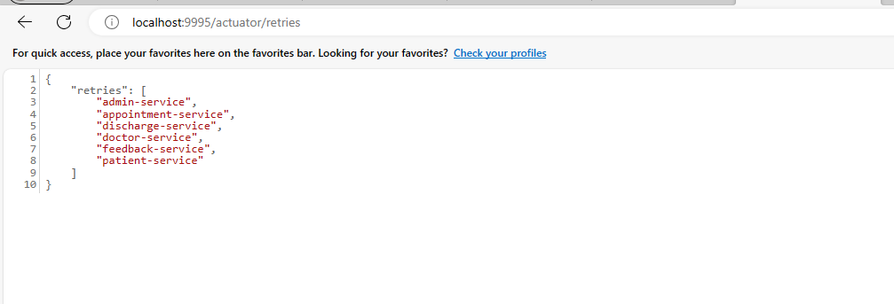
Retries

Slide 44
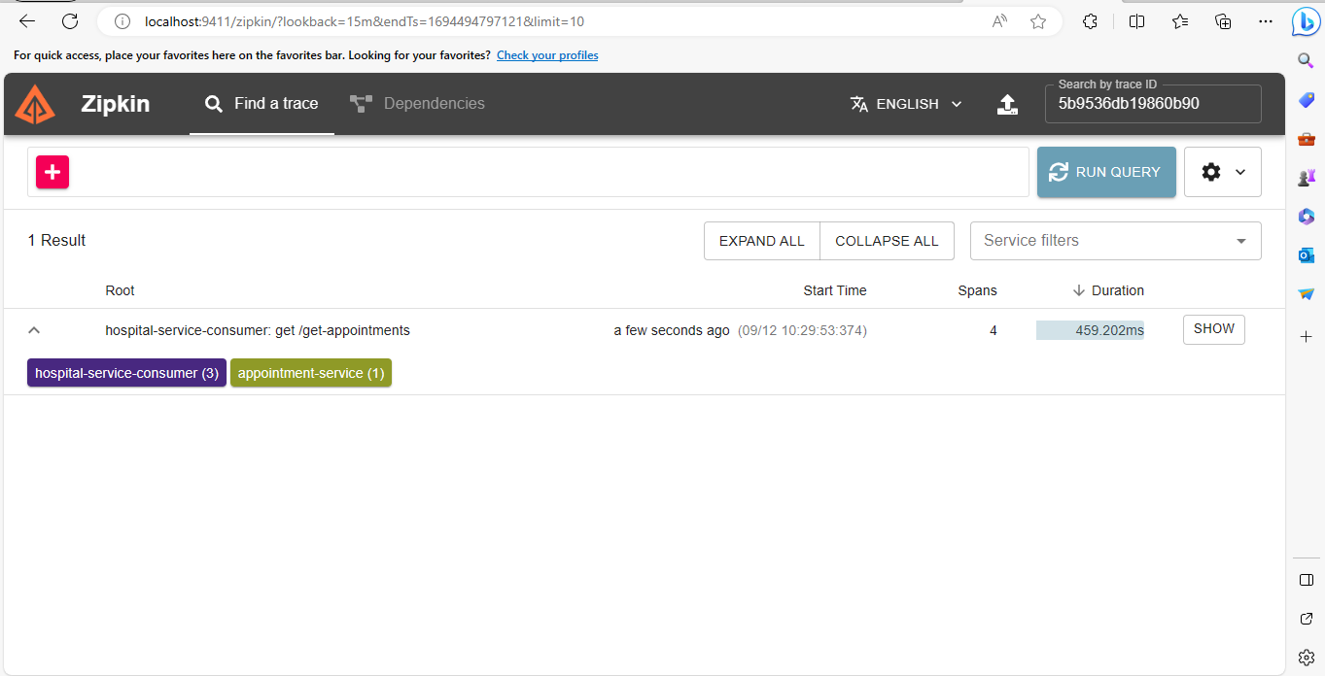
Zipkin

Slide 45
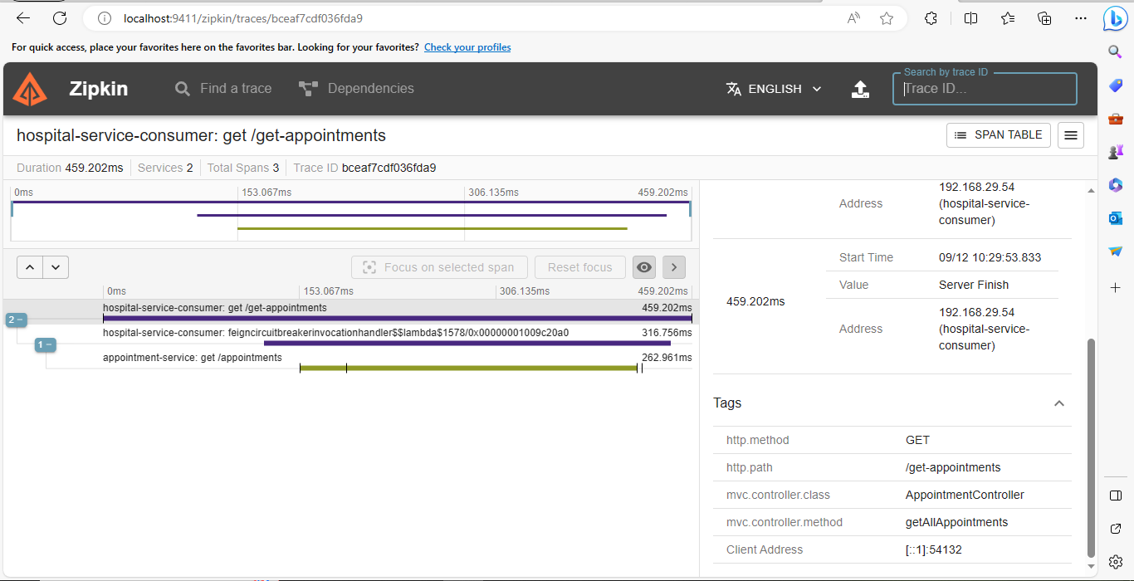
Zipkin

Slide 46
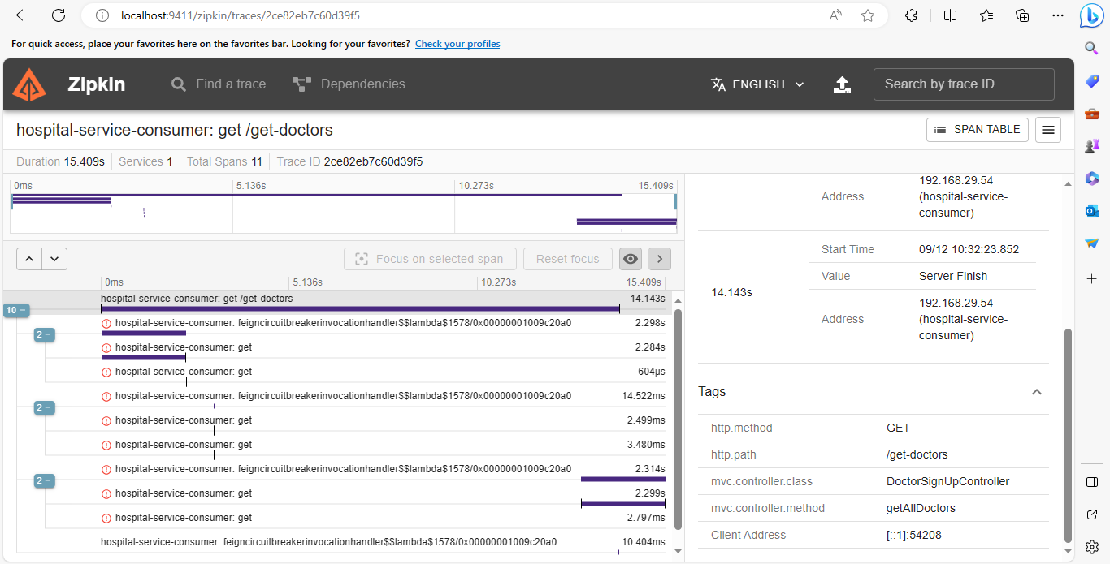
Zipkin

Slide 47


